Slide 1
JTLS-GO at the Norwegian Joint Headquartes
SFC Arne Eriksen
XO EXD
NJHQ
Notes:
Hello everybody,
My name is Arne Eriksen, I`m a Sergeant first class and I work as an Executive officer at the Norwegian Joint Headquarters.
This picture shows a how it was in Bodø in the Northeren parts of Norway when I left a couples of days a go.

Slide 2
NJHQ priorities
Hybrid Exercises
LIVE and SIM
CPX/CAX
Training of internal personnel.
Support JWC
Training
Notes:
Last year my former chief CAX (Sveinung Hegge) talked about how we at the Norwegian Joint Headquarters have tried to include simulation and JTLS-GO into our LIVE exercises
He talked about how we did this on Nordic response 2024 and from earlier we have also done this on Cold Response 2022. The last exercise we had now in March was Joint Viking 2025 and we did it there as well.
We will continue to have these hybrid Exercises as one of our main priorties.
We will still focus on traditional CPX/CAX exercises and that will be the arena where we are able to shine the most since all the forces are simulated. As always we will conduct at least one big exercise like this each year and to be able to do this we will do smaller internal exercises in order to train our operators.
We will always have training of internal personnel as one of our main priorities because of a high turnover in our group. We have conscripts that`s only with us for one year before we get new ones, and we hire some conscripts that stays for us for 2-3 years before they want to move on to other positions.
Because of this high turnover it`s really important to have a good education program internal and also use the possibilities that lies with the Center of Exelence and Joint Warfare center for courses and training.
One of our priorities is to support the JWC when we have the possibility to do that. They have more experienced operators than us and we also have a bigger turnover on our operators. So with that in mind, supporting JWC on exercises is a good way of training our operators at time same time as we are building a network together with to skilled staff at the JWC.

Slide 3
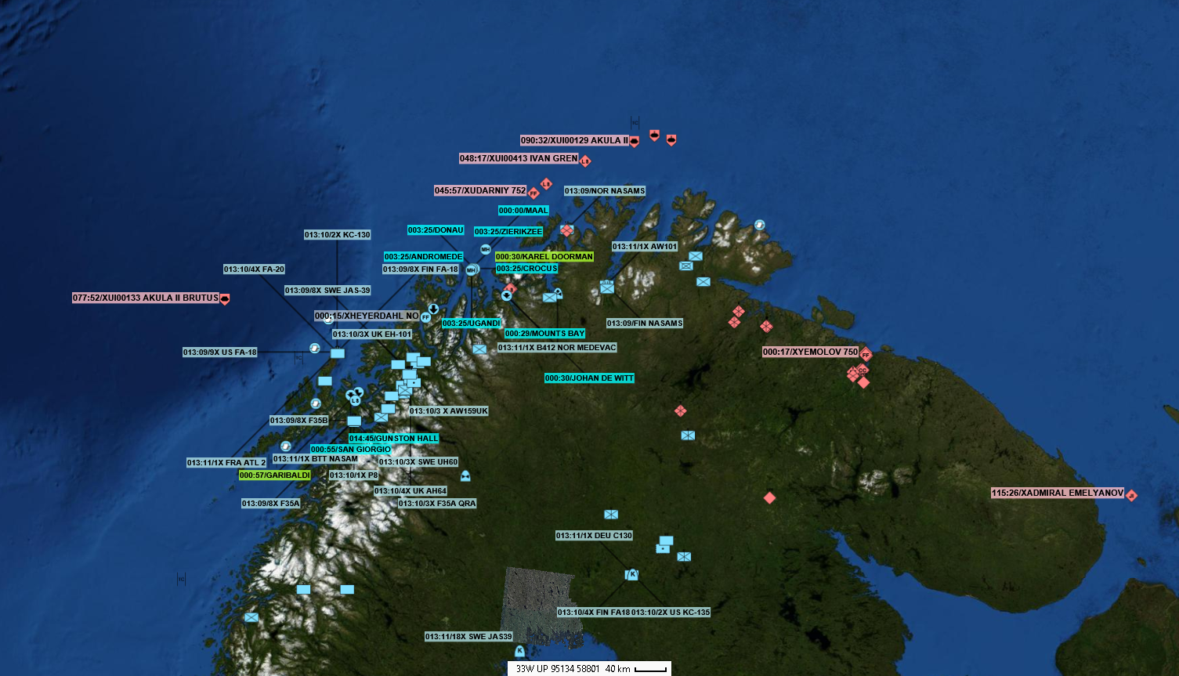
Latest Exercises
Cold response 2022
Nordic response 2024
Joint Viking 2025
Notes:
The impact simulation have had on these exercises have been very different because of the size of the exercise and who`s the training audience.
Cold response was a small exercise and the first time we tried to combine simulated and LIVE forces in the same picture. We did this only to facilitate for parts of the Norweigan Joint Headquarters, but still we did combined the different feeds into a C2 system.
For Nordic Response 2024 it was a big exercise with participations all the way up to strategic level and our simulation was part of the COP together with the LIVE forces. This meant that the decision makers had to take decisions without actually know if the forces were live or simulated.
For Joint Viking 2025 the tactical level was the Primary training audience and they were well aware of which forces that were live on the ground and not. But still they used the COP an the entire picture to make there dicisions.

Slide 4
Looking forward
3 year exercise cycle together with NATO.
Continue with HYBRID Exercises
Working together with lower level simulation
Cooperation with the other Nordic nations.
Notes:
When we are looking forward we are looking forward together with NATO and have adjusted are exercise cycle to match NATO`s 3 year cycle with an increasing ambition for each year. This is the plan for the LIVE exercises, but since we are treating them as HYBRID exercises it as an impact on our simulation team also.
And that is our main goal now, continue with HYBRID exercises and do the best we can to have an impact for HQ`s on a live exercise where the amount of troops on the ground is lower than the exercise wanted. We also see that when we are present with our CAX team on these LIVE (Hybrid) exercises we get request during the exercise to do more than what was planed because it is needed to help Training Audience reach their Training Objectives.
I started at the CAX team at NJHQ in 2021 and early there was not to much talk about it, but the last 2 years and more now the last year I have hear people talk about connecting JTLS-GO together with lower level simulation systems. And also from participation on CWIX I see that the M&S area there has been growing and the same topic has been presented there.
The main thing here is that people want to exploit our truth from an operational/strategic level into the tactical/sub-tactical level to act out parts of an exercise there. The most recent case is with the Norwegian Batlelab and experimentation where they are exploring and experimenting with some different simulation systems and they want to see how and if these can be connected to the JTLS-GO. Of course this will demand more of the people planning the exercises when they want to have detailed training objectives on different levels. It would also be nice to see the result of a simulation from a tactical simulation coming back into the JTLS-GO.
Now that our close neighbors Finland and Sweden have join the alliance we want to explore more of the opportunity to simulate together with them. Maybe in the future we can have a Nordic simulation center or at least a Nordic simulation forum and we are able the plan the simulation part of CPX`s and/or Hybrid exercises together.

Slide 5
Thanks for the attention! Any questions?

